Slide 1

SALES DATA ANALYSIS
Chennaboina.Bhavani

Slide 2
Project Overview:
Project Title: Sales Data Analysis
Domain: Retail / Business Analytics
Tool Used: Python
Libraries Used: Pandas, Numpy, Matplotlib.
Dataset Type: Monthly Sales Data
Objective: To analyze and visualize monthly sales performance using Python
Python Notebook:
Python Notebook is an interactive environment used to write, execute,
And visualize Python code in cell format.

Slide 3

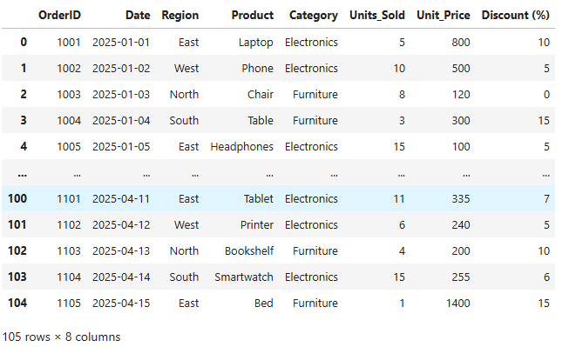
Data preprocessing Tasks
Load data using Pandas :

Slide 4
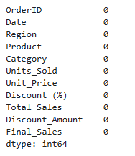

Table shape:
Check for missing Values
Table Columns:

Slide 5

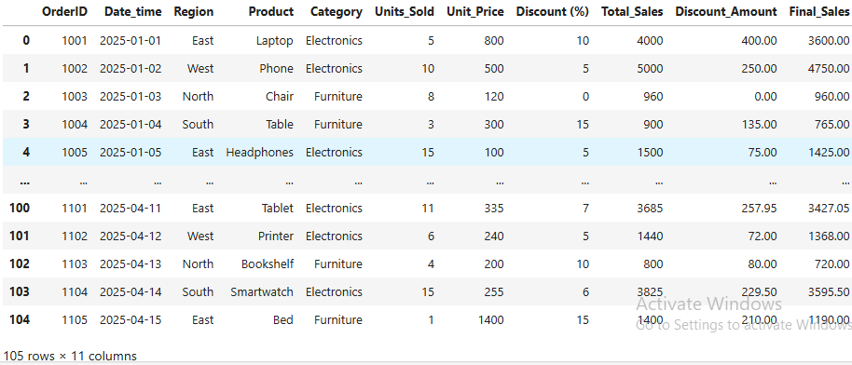


Create new columns: 1.Total_sales=Units_Sold * Unit_price 2.Discount Amount 3.Final_Sales=Total_Sales-Discount
Convert Date column to datetime
Create new columns :Total Table

Slide 6


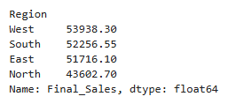
Analaysis:
1.What is the total revenue
3.Which Category perform best
2.which region has highest sales

Slide 7

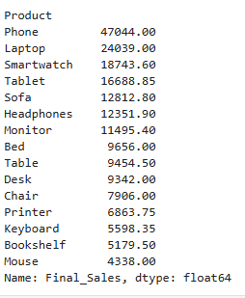
4.What is the average discount
5.Which product generates highest profit

Slide 8
6.Correlation between discount_Amount and units sold
Calculate Total_Sales:mean sales
Standard deviation
Variance

Slide 9
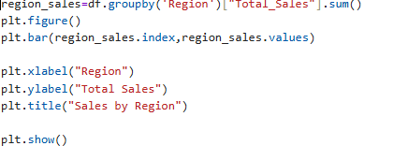
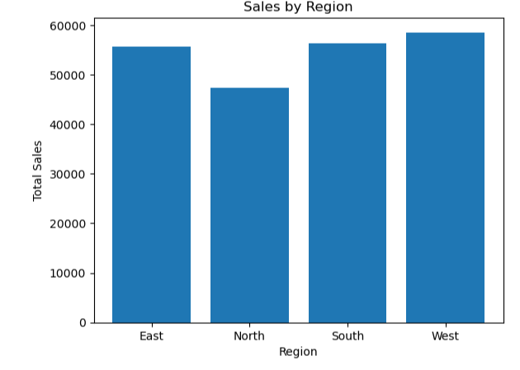
Sales By Region using in Bar chart
Visualizations:(Matplotlib)

Slide 10
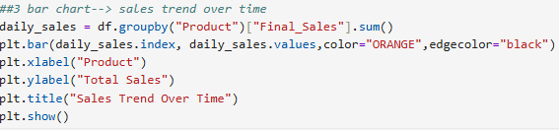
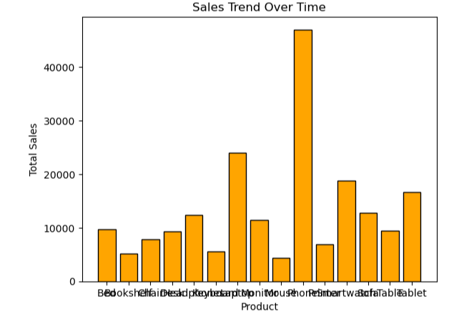
Sales trend over time using In Bar Chart

Slide 11
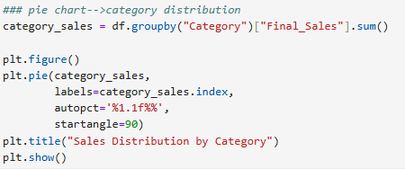
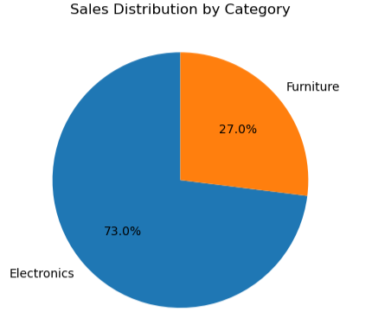
Category Distribution of Final Sales using with Pie chart

Slide 12

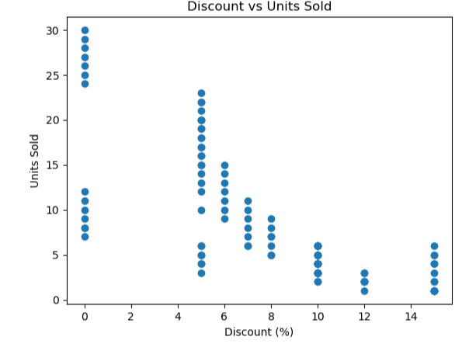
Discount vs Units Sold using Scatter plot

Slide 13
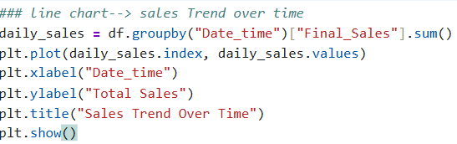
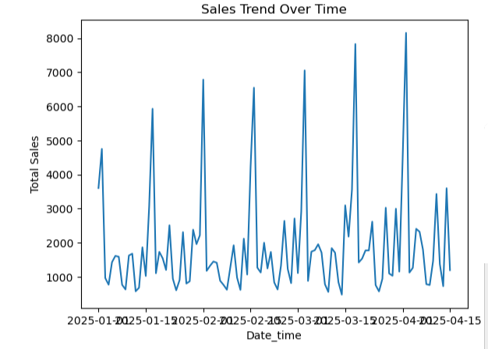
Sales Trend Over Time using in line chart

Slide 14
Conclusion:
The sales data was successfully analyzed using python libraries like “pandas”,”numpy” and “matplotlib”.
Data cleaning was performed :
i: Handled missing values,
ii: Converted date formats.
Monthly Sales trend shows clear growth/decline patterns.
Category-wise analysis identified top-performing products.
Reginal analysis helped identity high-revenue areas.
Visualization: 1.Bar chart
2.Line chart
3.pie chart
4. scatter plot
Predictive analysis(Linear Regression) Helped estimate next month sales.

Slide 15
Thank you

